Slide 1
DevOps Project
Automated application deployment process and secure configuration of AWS application servers
Yarmak Artem
Epam 2021 DevOps

Slide 2
Task description​
Automated and fast deployment application and configuration
In project I used:
Amazon Web Services;
GitHub;
Jenkins;
Ansible;
Juicy Shop.

Slide 3
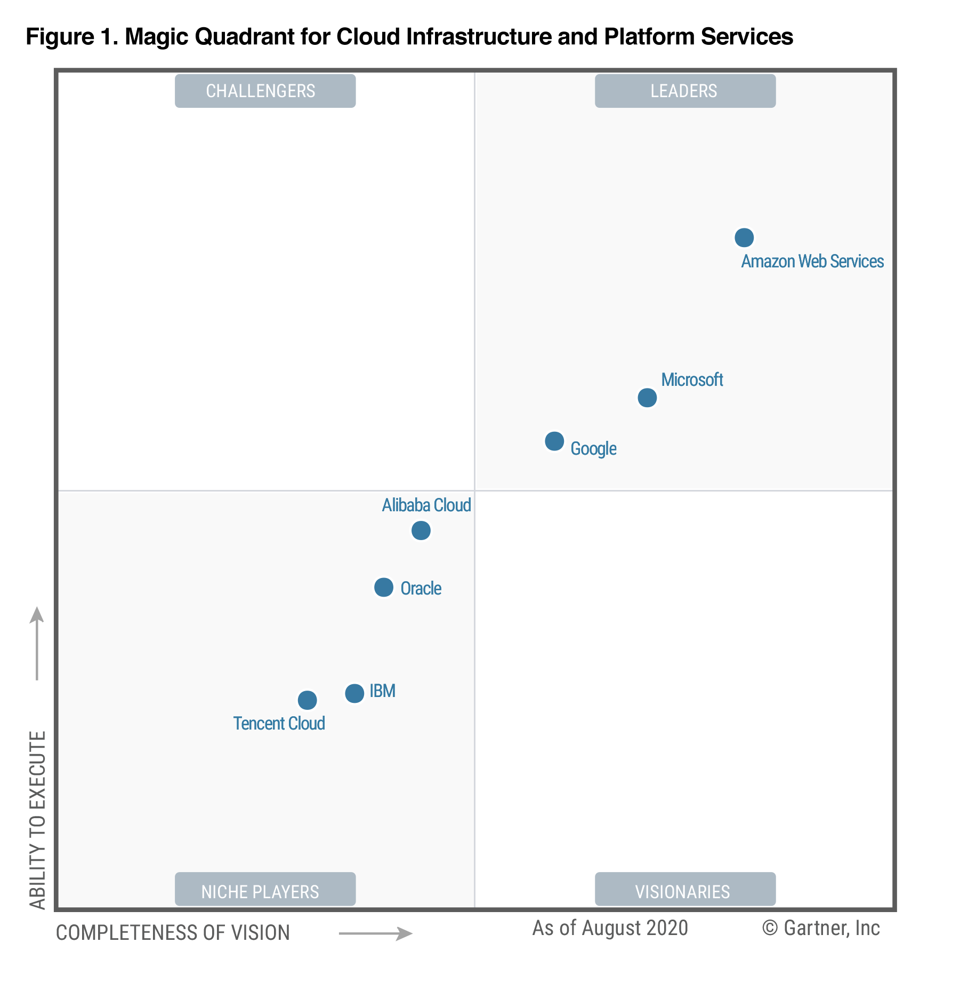
Amazon Web Services
Amazon Web Services (AWS) is a secure cloud services platform, offering compute power, database storage, content delivery and other functionality to help businesses scale and grow.

Slide 4
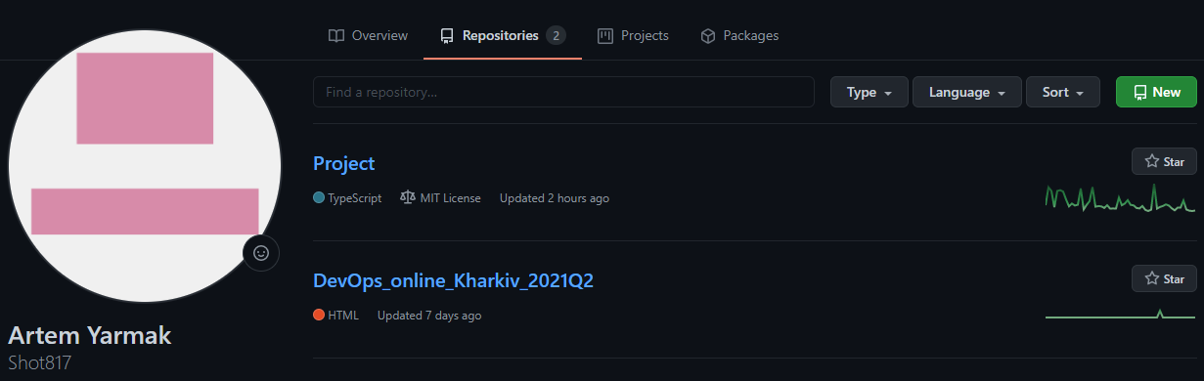
GitHub
GitHub is a code hosting platform for version control and collaboration. It lets lots of peoples work together on projects from anywhere.

Slide 5
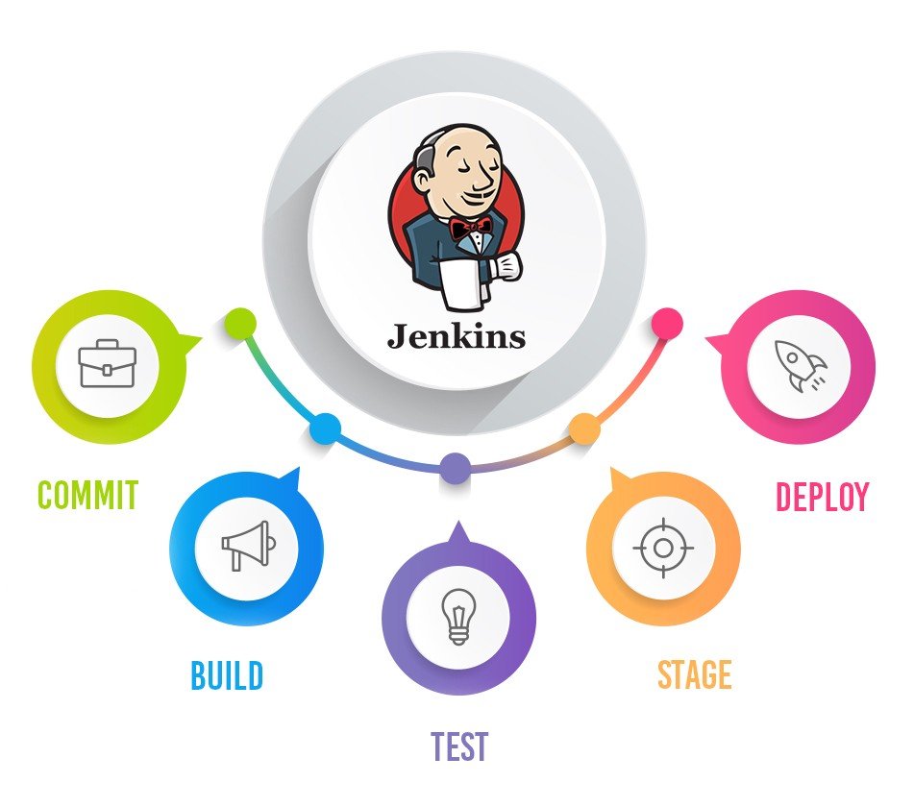
Jenkins
Jenkins is an open source Java software system designed to provide a continuous software integration process

Slide 6
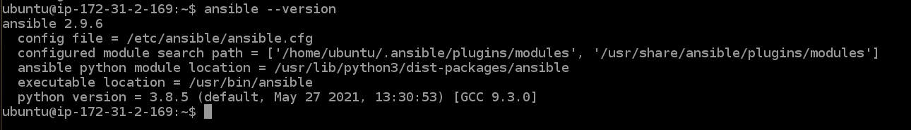
Ansible
Ansible is a configuration management system written in Python using a declarative markup language to describe configurations. Used to automate software configuration and deployment.

Slide 7
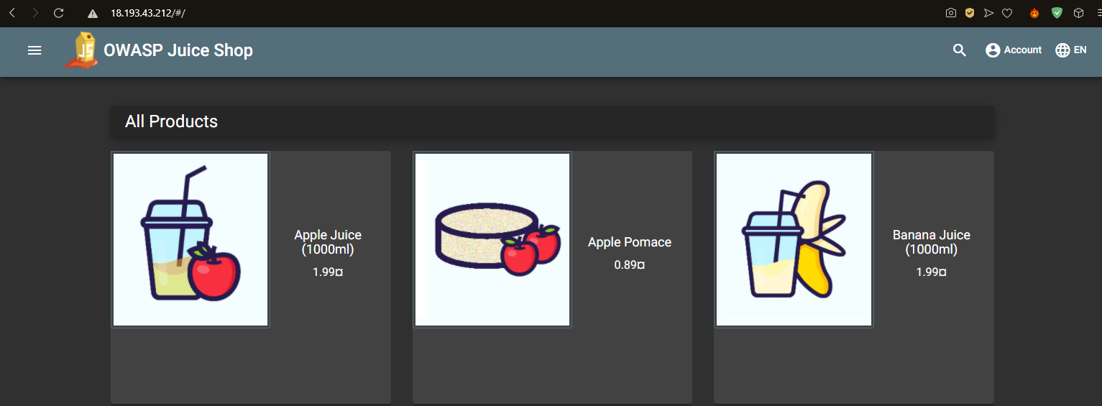
Juice Shop
It is a intentionally vulnerable web application for security training written in JavaScript. It's filled with hacking challenges of all different difficulty levels intended for the user to exploit and is a fantastic way to begin learning about web application security.

Slide 8
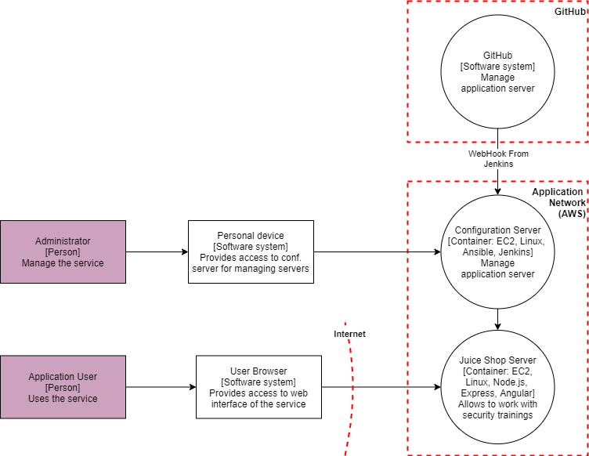
Project Outline

Slide 9
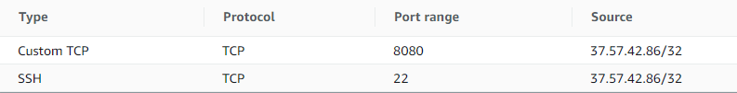

First of all I created 2 instances on AWS
Configuration server
Juicy Shop
Second step was to configure secure connections to instances
To configuration server only from my own work space
To Juicy Shop only from configuration server

Slide 10
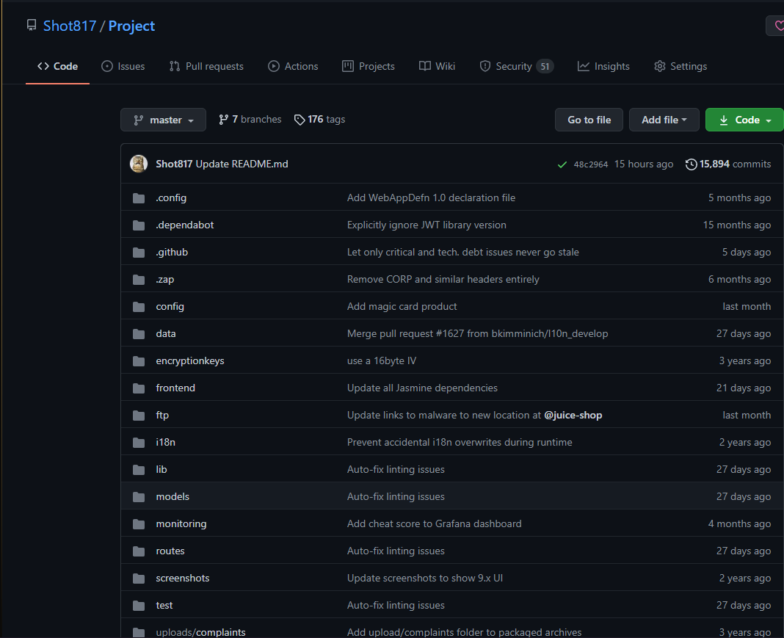
On GitHub I created a repository where my project and instance configurations will be stored

Slide 11
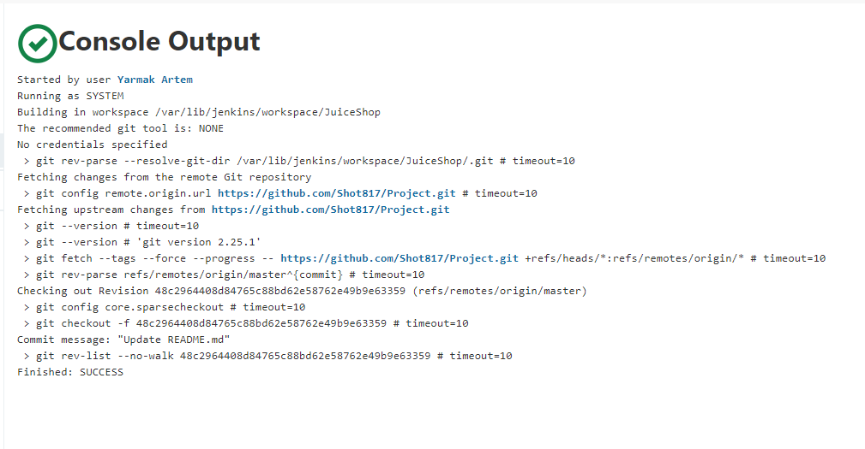
On Jenkins I created a task for GitHub and configuration instance connection

Slide 12
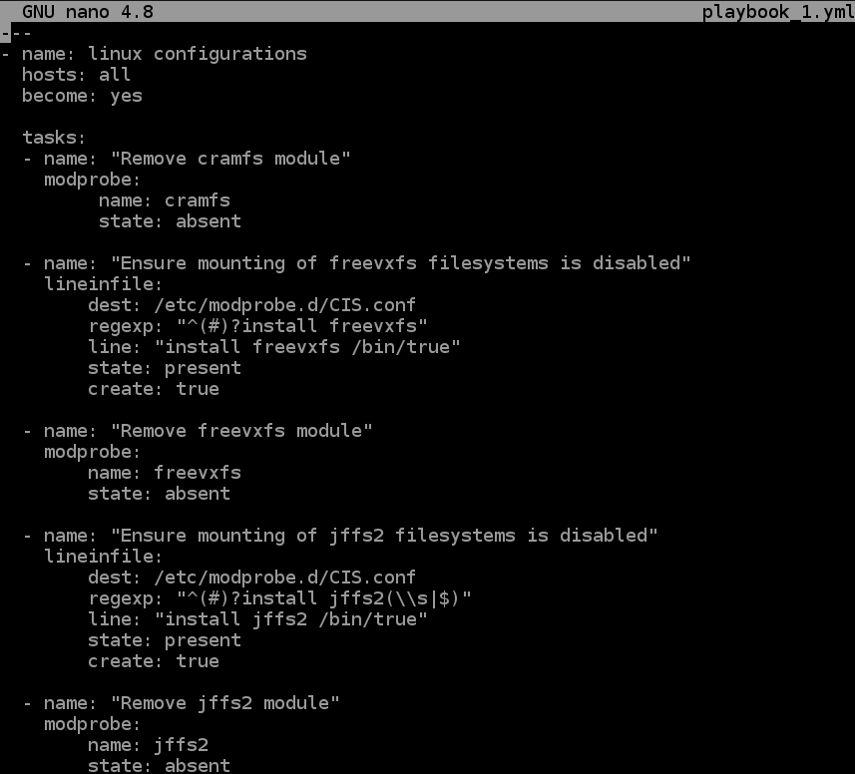
On Asnsible I created inventory file “hosts”
And playbook with secure configuration rules

Slide 13
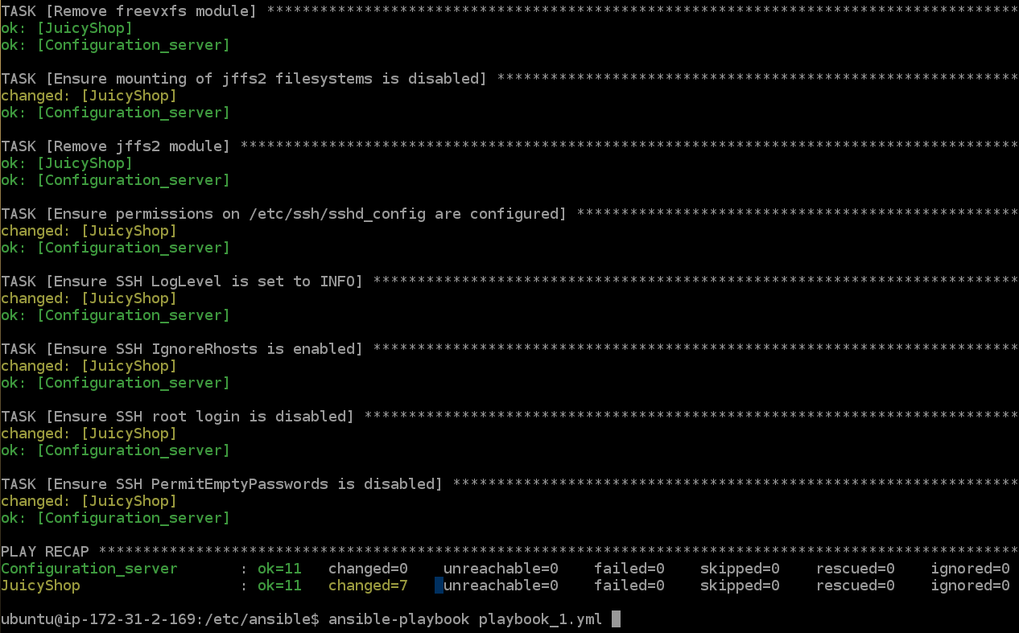
Running playbook with secure configuration rules

Slide 14
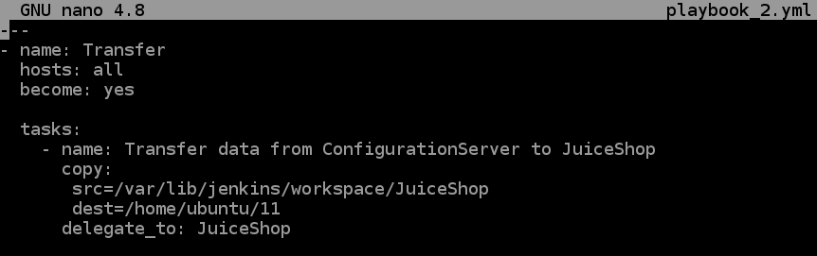
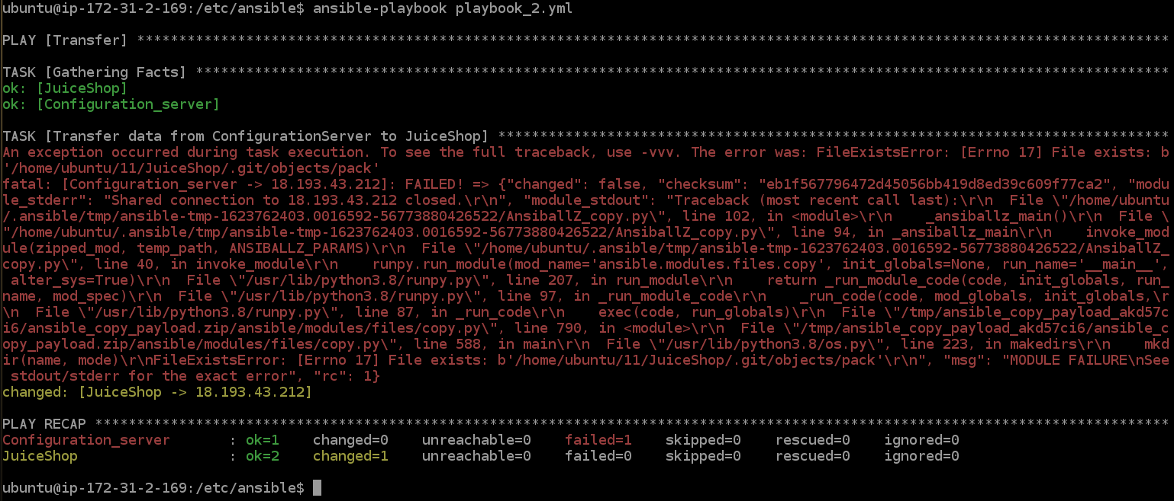
Running playbook with Juicy Shop transportation to the desired instance

Slide 15
Thank you for attention!

